Slide 1


Model Design
Treasure Valley Groundwater Flow Model Training
Stephen Hundt, USGS (shundt@usgs.gov)
March 14th, 2023

Slide 2
Contents
Model basics
Non-irrigation boundaries and stresses
Irrigation boundaries and stresses

Slide 3
Model basics

Slide 4
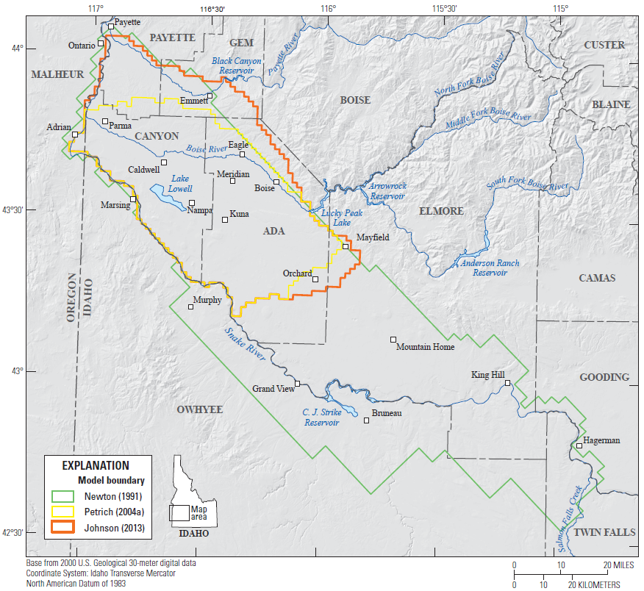
Study area

Slide 5
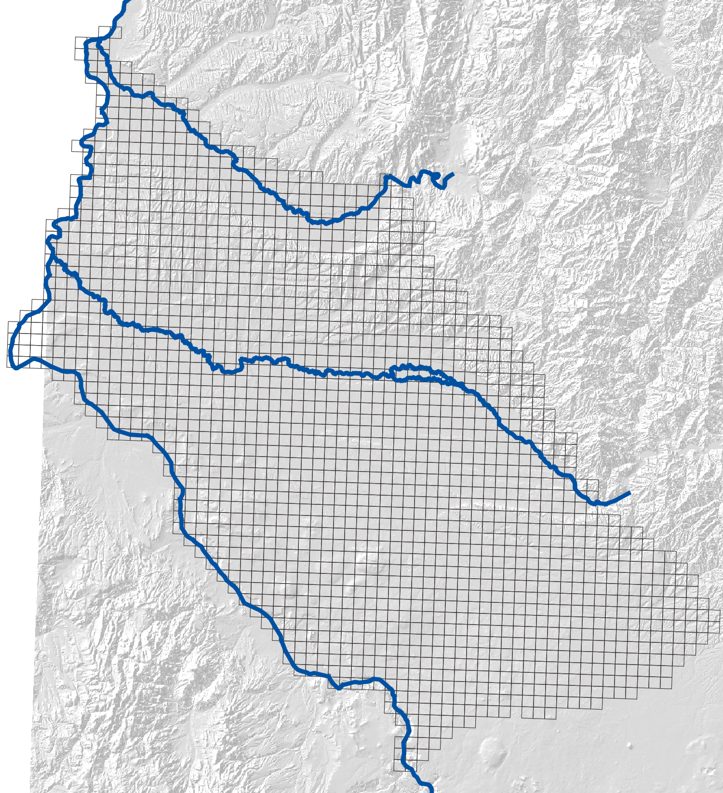
Grid
64 x 65 1 mile square grid
Regional model, 1 mile cell, doesn’t have all local heterogeneity, not designed for impacts of individual pumping wells or the impact at individual observation wells

Slide 6
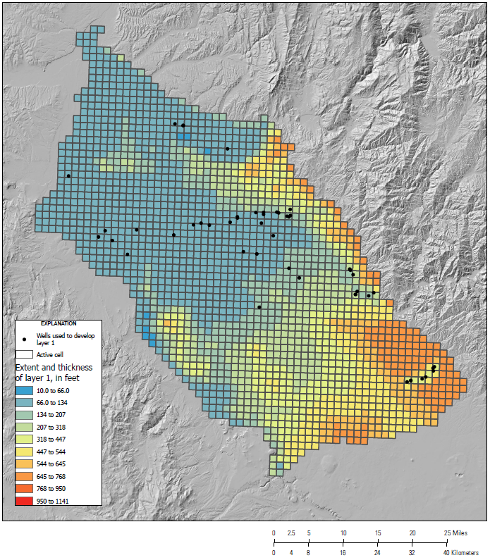
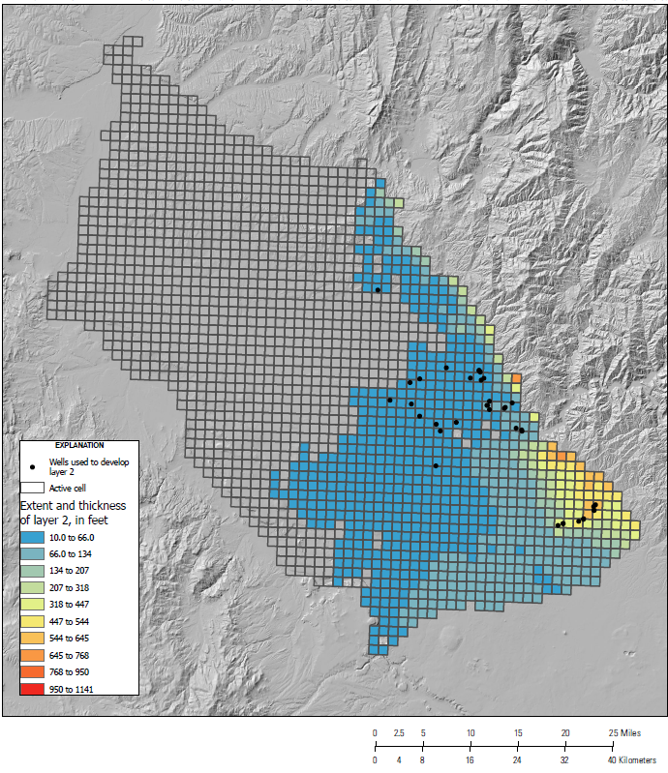
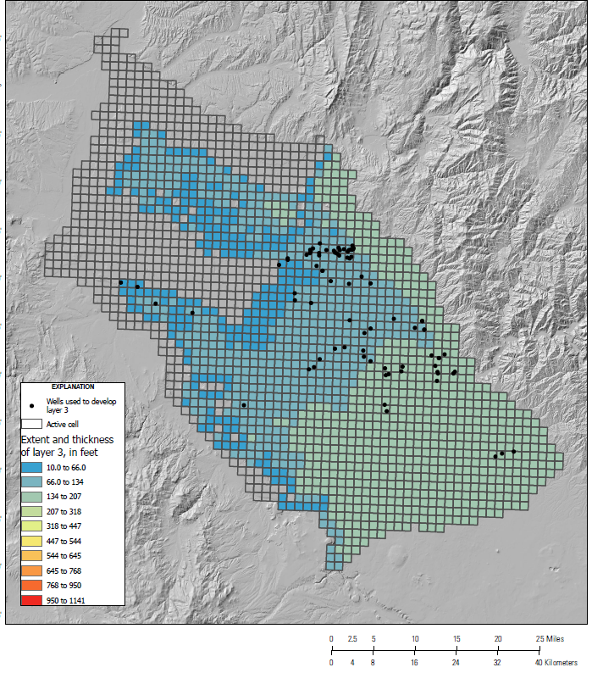
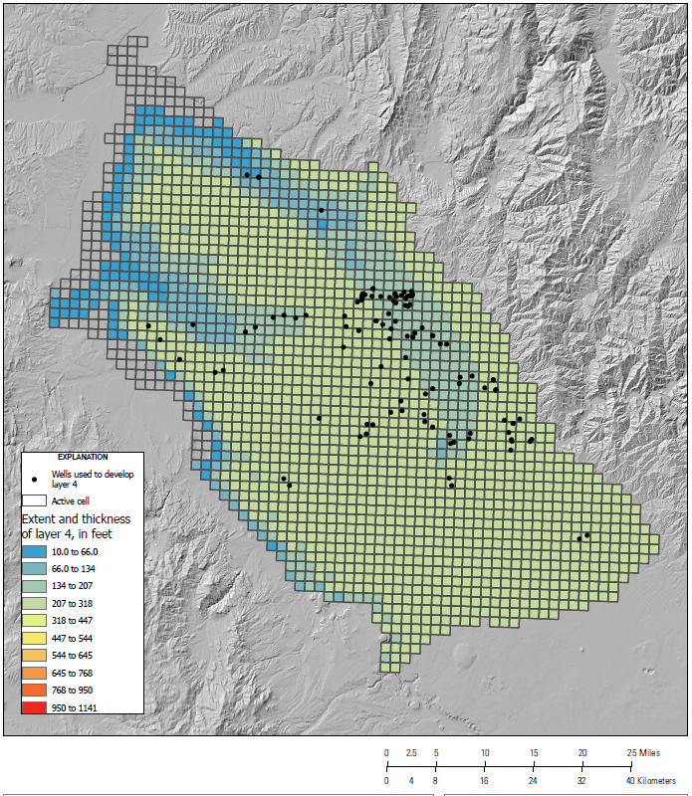
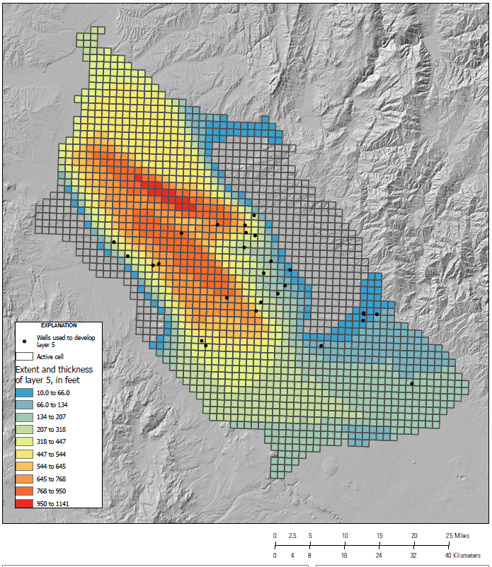
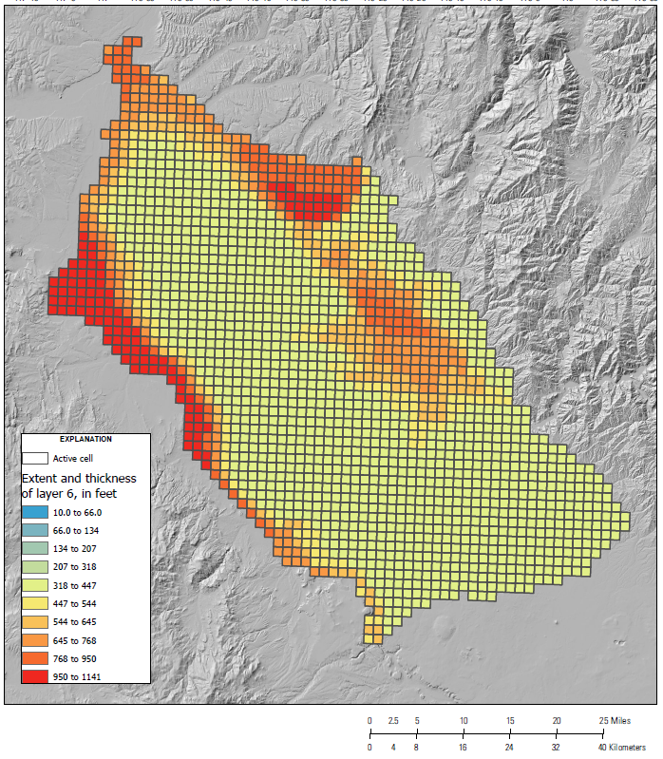
Layers
6 layers – chosen mostly from observed vertical head gradients
Incorporates info from hydrogeologic framework
Several pinch in the west

Slide 7
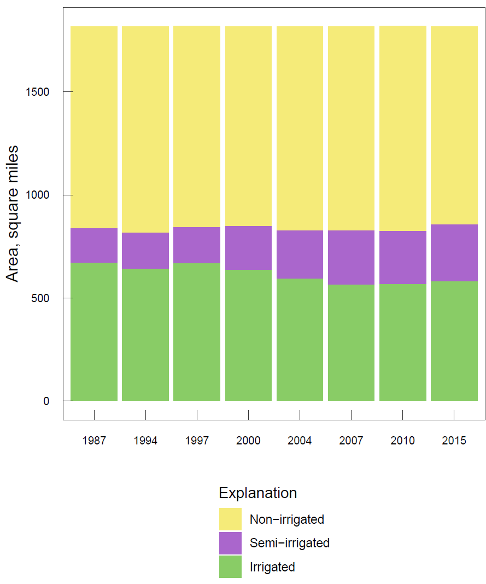
Time
360 monthly periods
1986-2016
Most stress data is precise to 1 month or larger periods
Not all data available during the whole period
Change over the period

Slide 8
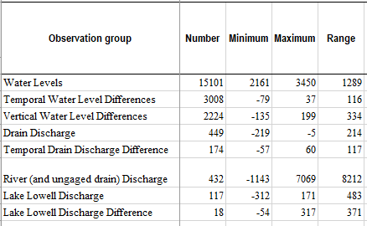
Observation targets
Water level and flux targets and derivatives thereof

Slide 9
Non-irrigation boundaries and stresses

Slide 10
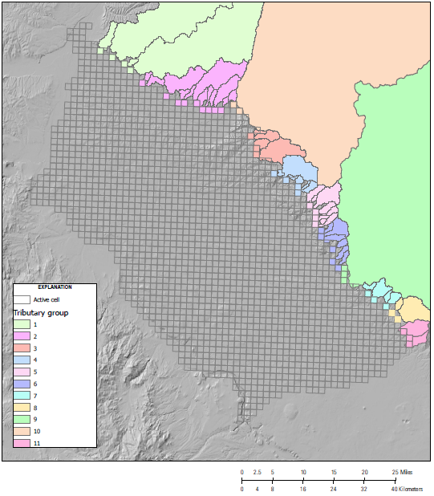
Tributary underflow
Based upon precipitation in tributary watersheds
Enters at cells on boundary

Slide 11
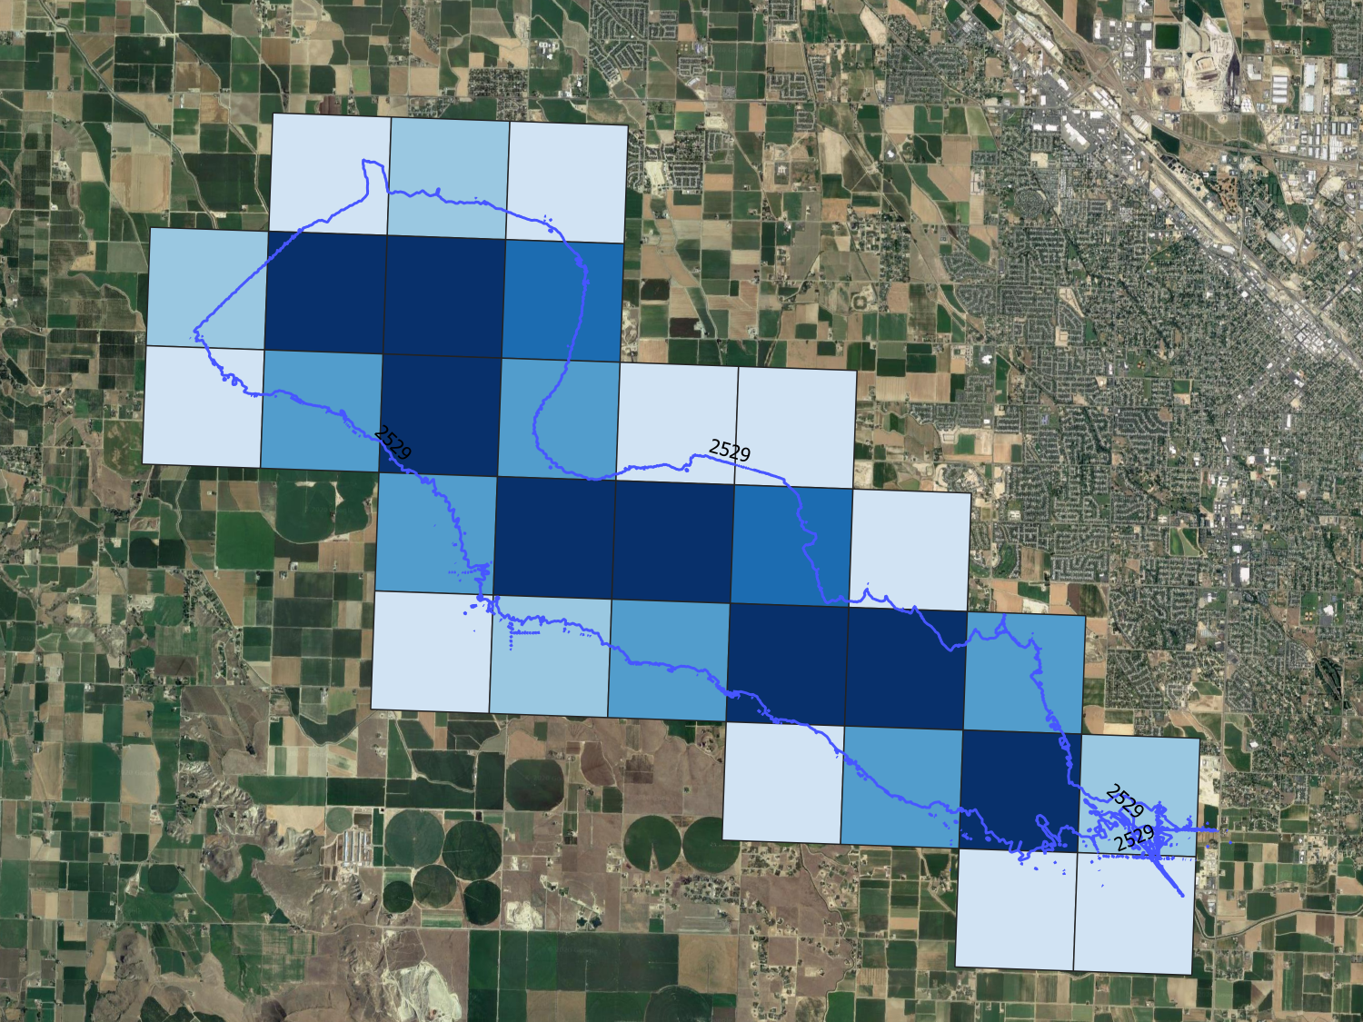
Lake Lowell
General head boundary
Covers multiple cells
Surface area varies with time – multipliers applied to adjust when lake doesn’t fully cover model cell
Stage varies with time

Slide 12
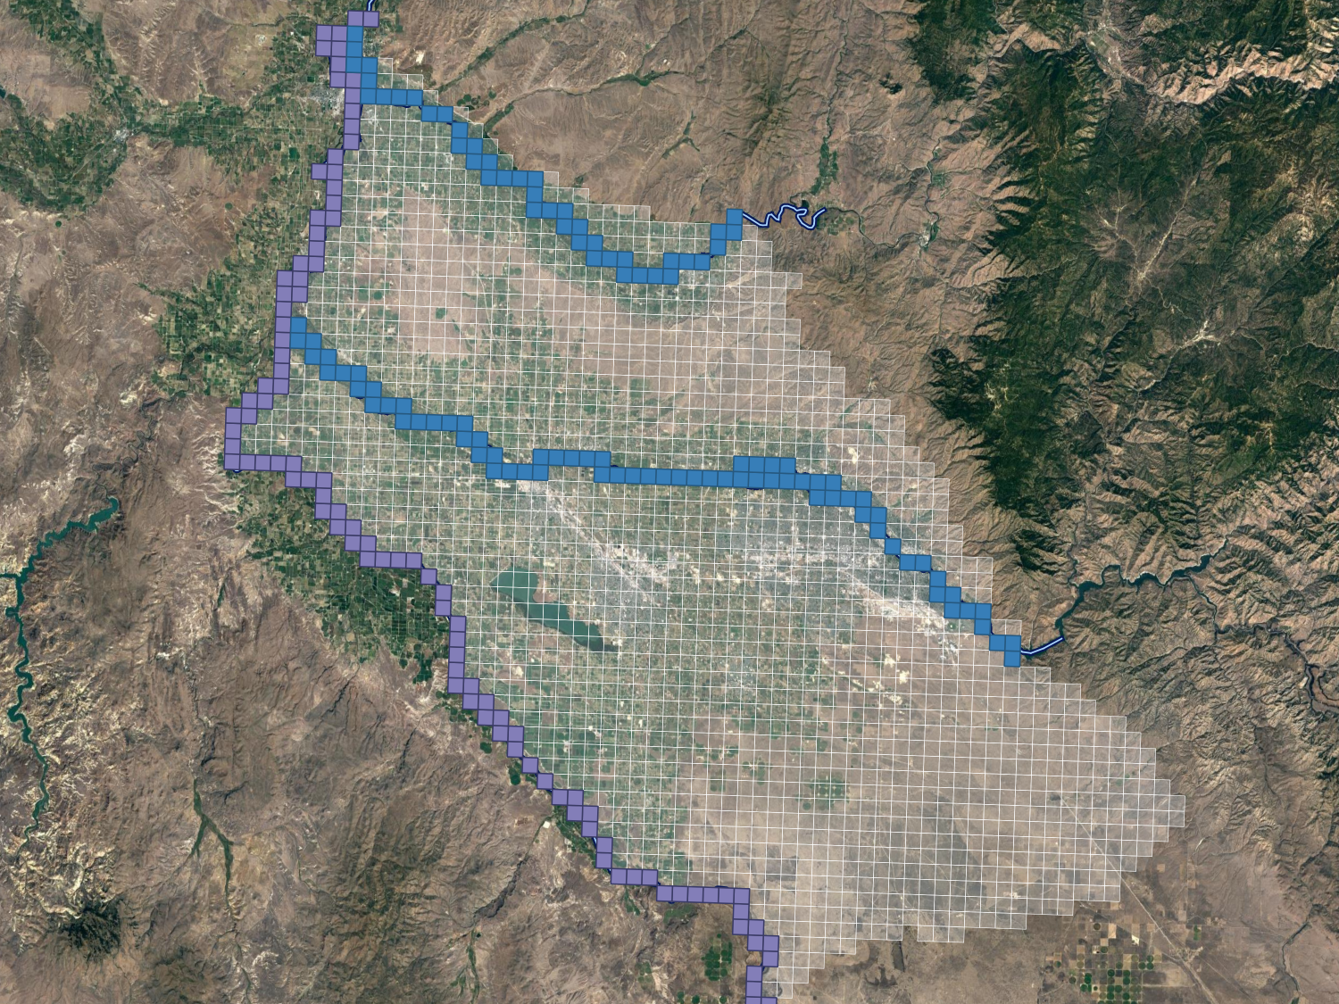
Rivers
River package
Stage varies with time in Boise and Payette
Divided into reaches with equal properties and between gaging locations

Slide 13
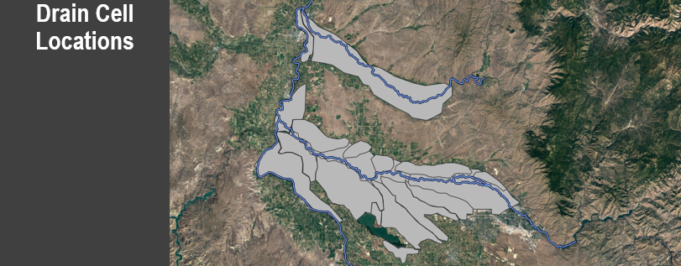
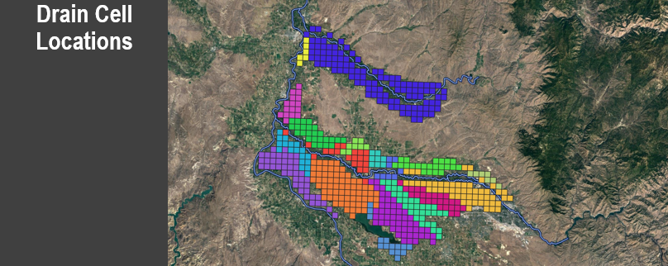
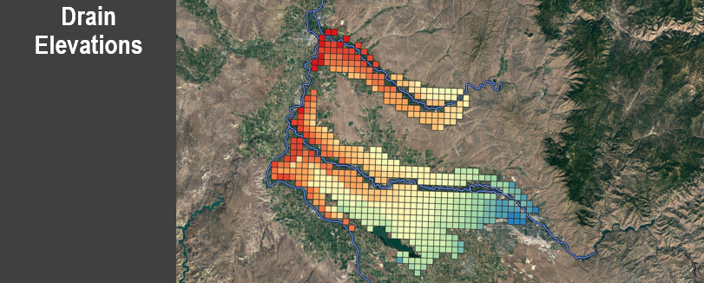
Drains
Drain boundary
“Catchment” areas of major drains mapped
Drain catchment areas have equal conductance
Major source of discharge
Good control on these with drain discharge observations

Slide 14
Irrigation boundaries and stresses

Slide 15
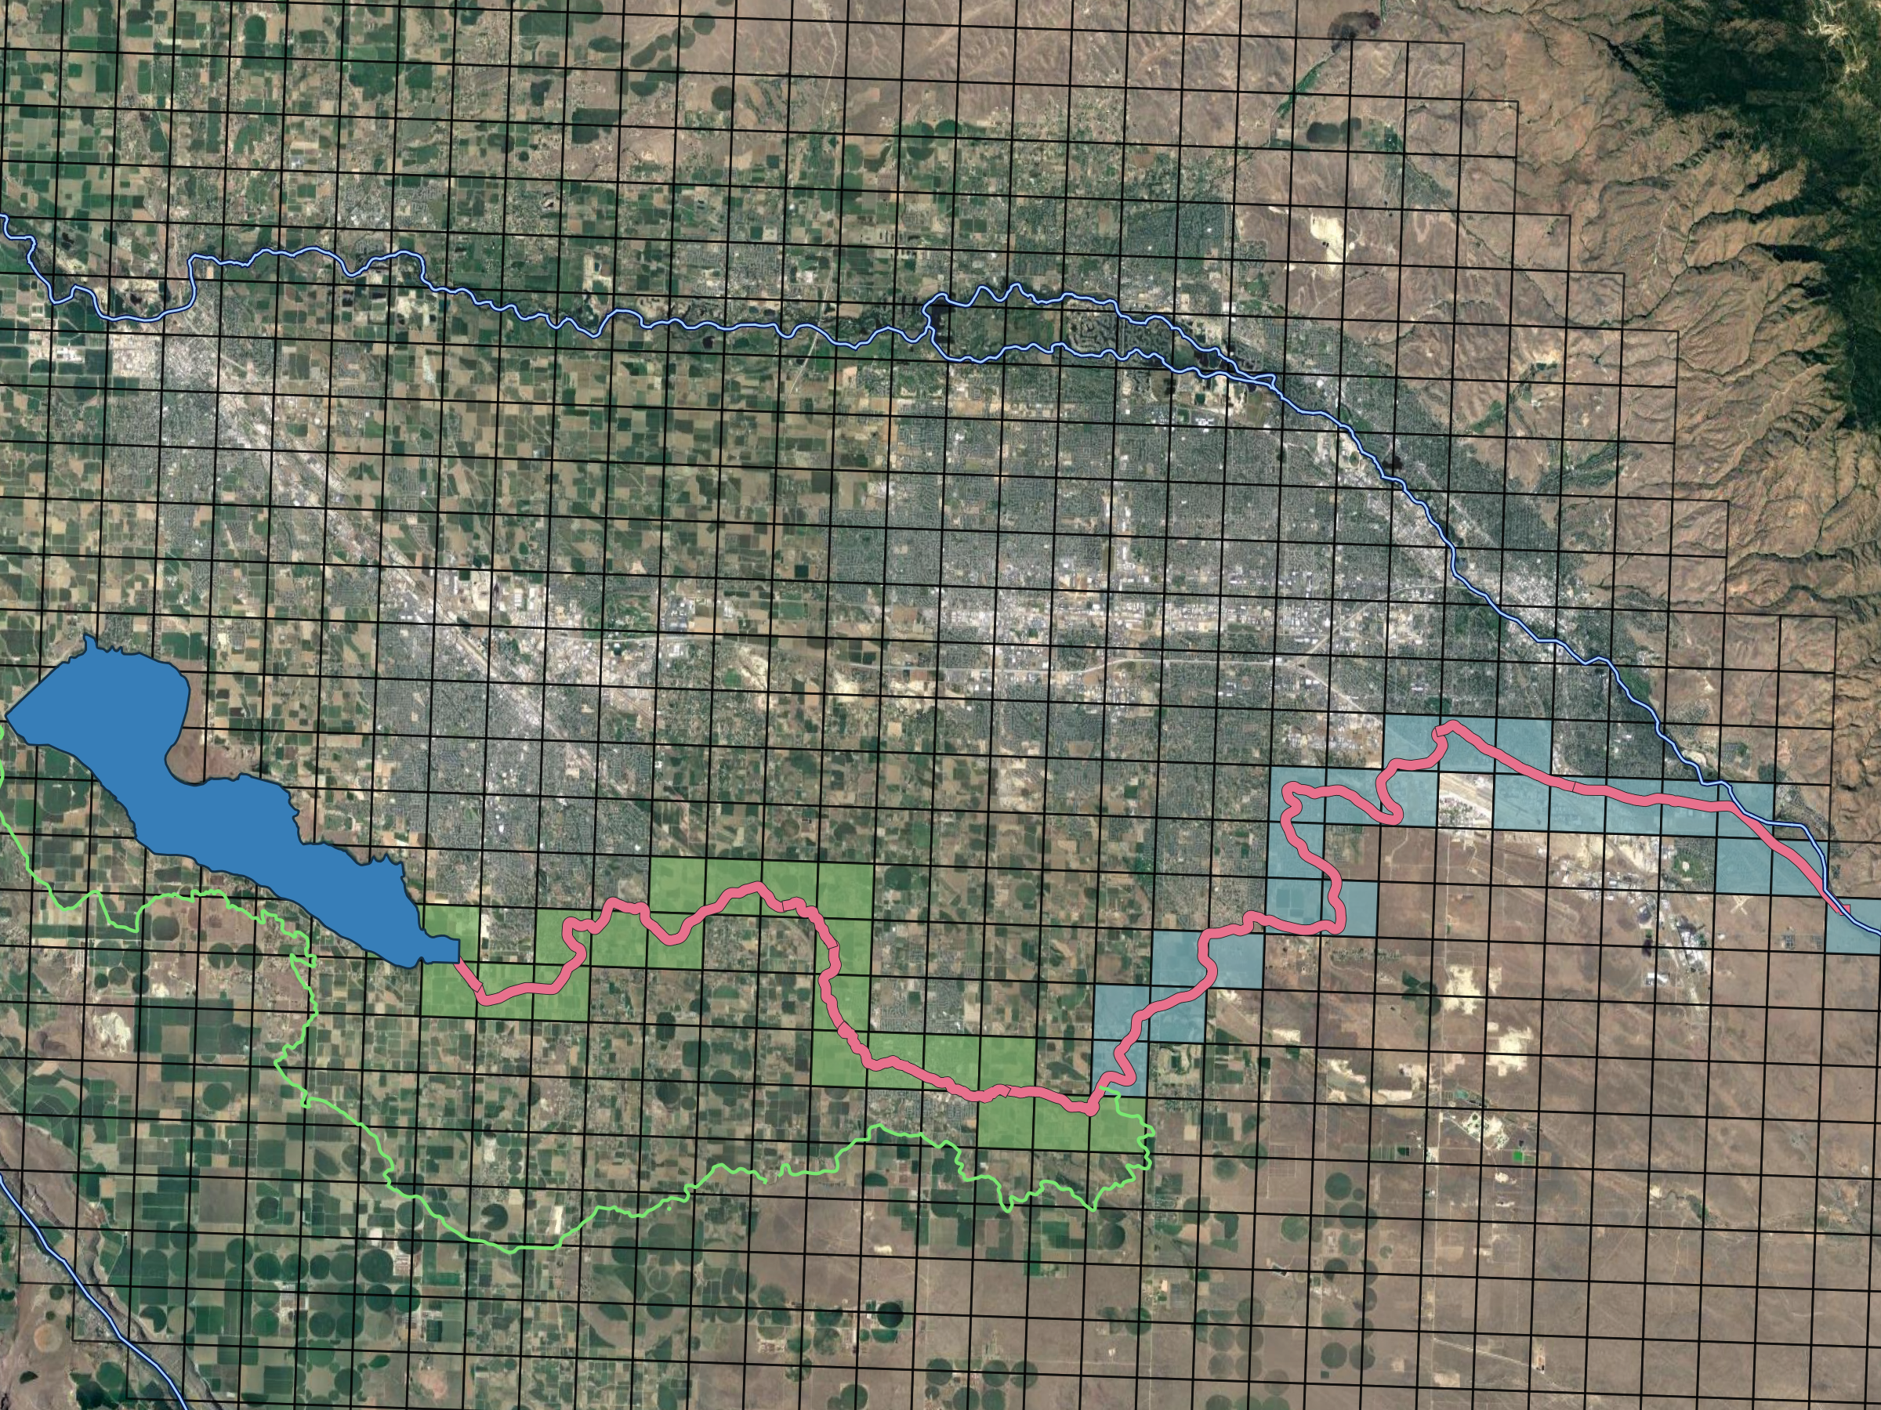
Canal leakage: New York Canal
Upper
Well package
Leakage set as percentage of diversion in canal
Multipliers applied to cells in proportion to length of canal within cell
Lower
River package
Areas of high water table

Slide 16
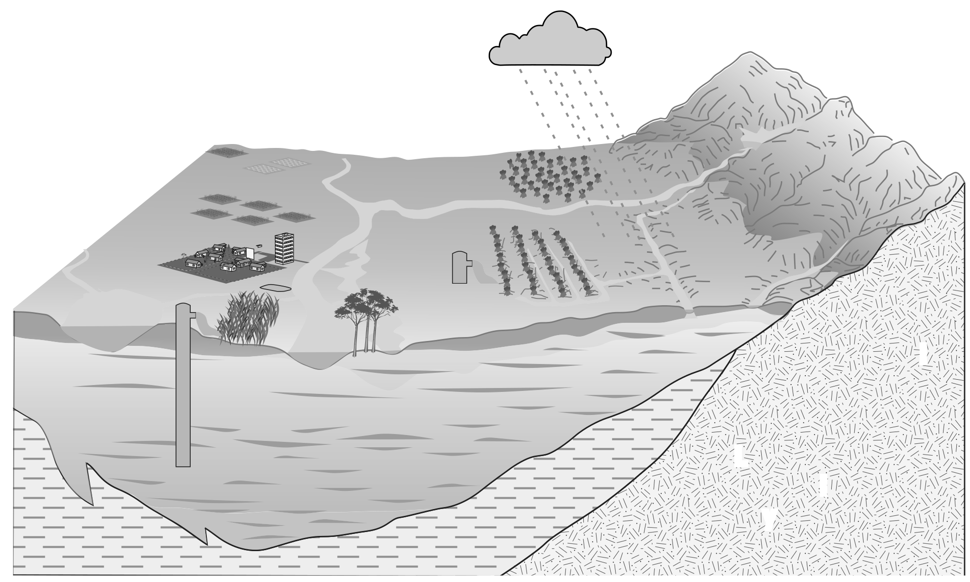
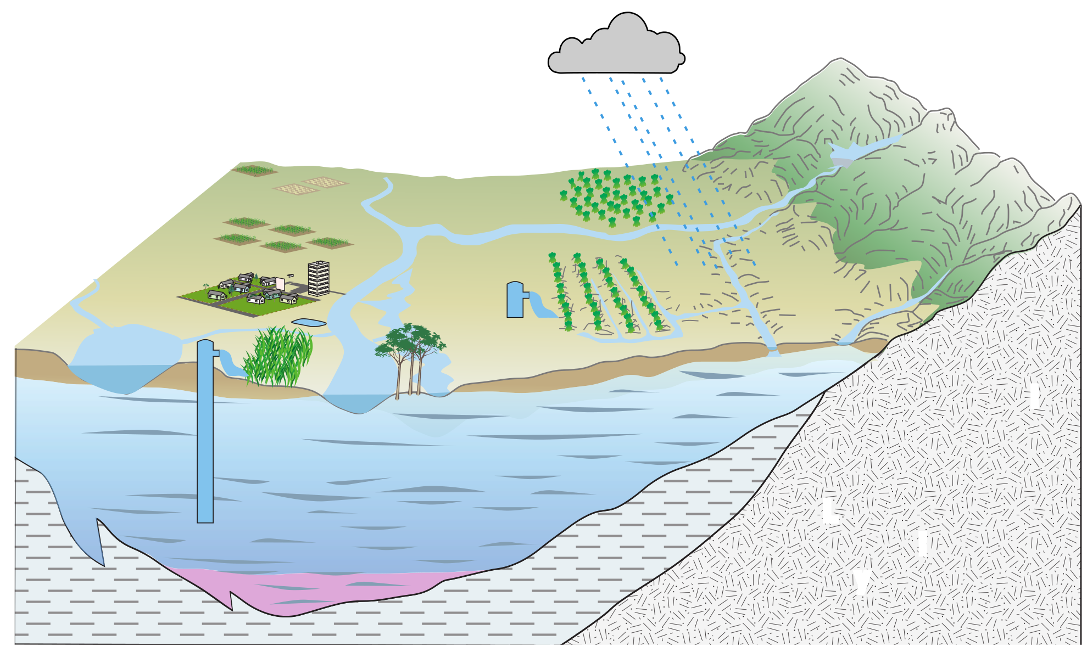
Canal leakage: Other
Well
Set as proportion of diversion to an irrigation entity
Only information is diversion to irrigation entity, location of fields, and location of canals
(modified from Faunt, 2009)

Slide 17
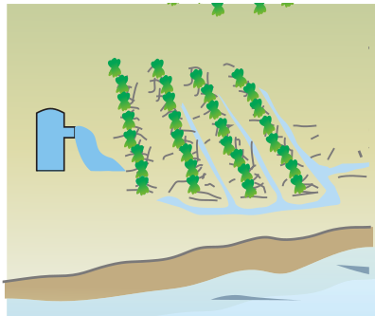
Incidental recharge
Well package
Estimated
Agricultural and (sub)urban have different properties
(modified from Faunt, 2009)

Slide 18
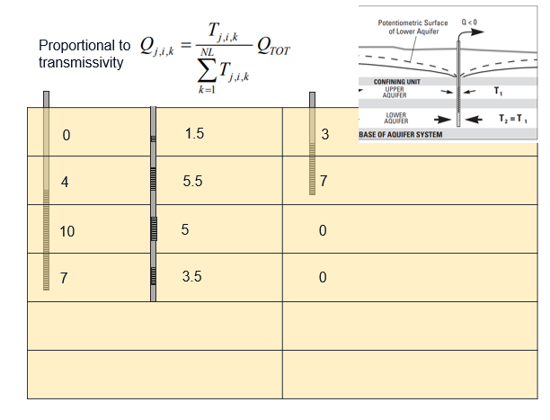
Pumping
Well package
Measurements were available for some municipal and industrial
Other (most) pumping is estimated
Pumping from multi-layer synthetic wells is distributed in proportion to K * open length

Slide 19
Data sources
Didn’t have direct estimates for these stresses (except some pumping)
Irrigation entity area
Diversions
Irrigation status
Evapotranspiration
Precipitation
Canal locations
Groundwater water rights
Well construction

Slide 20
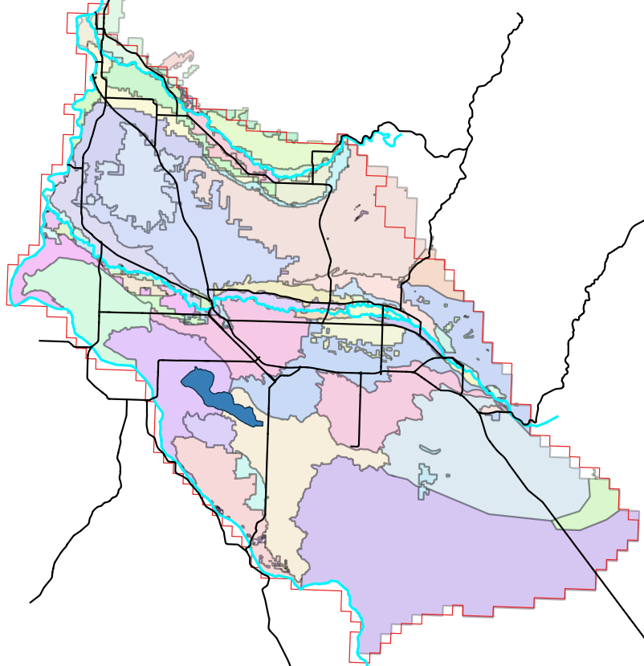
Irrigation entities
Locations of irrigation entities from state
A few smaller ones were combined
Deliveries from diversions are only known at this scale

Slide 21
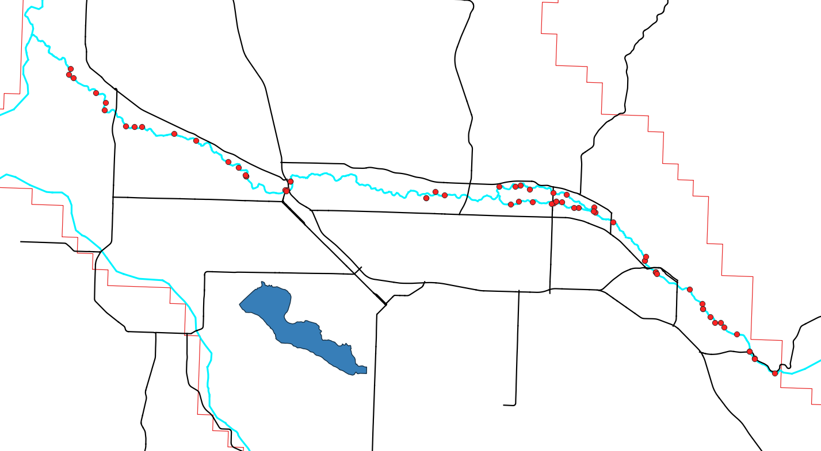
Diversions
sdf
Locations on the river
Monthly volumes
Irrigation entity (destination)

Slide 22
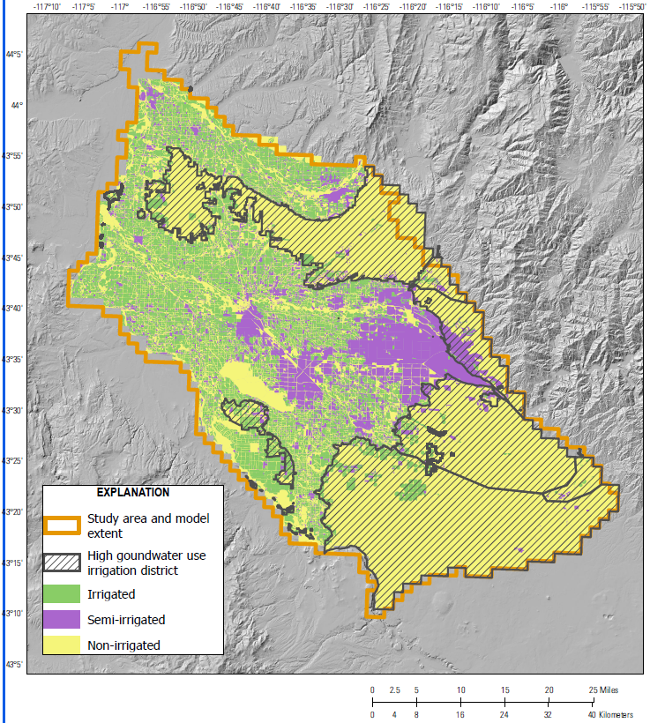
Irrigation status
Eight years were meticulously digitized
Irrigated, semi-irrigated, non-irrigated
Used to set irrigation related fluxes and properties

Slide 23
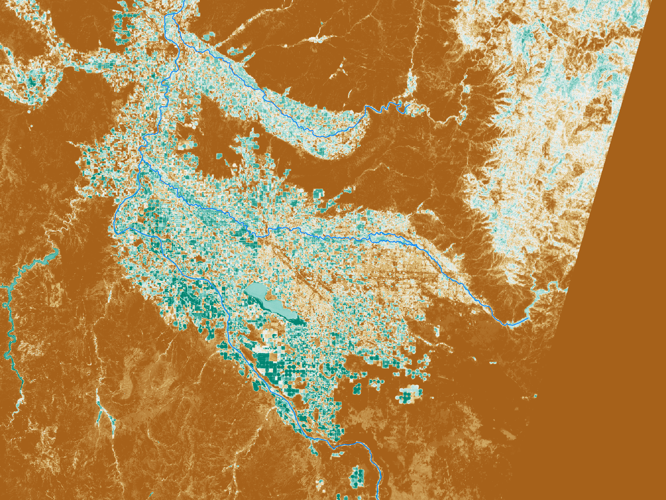
Evapotranspiration
sdf
Monthly evapotranspiration rasters with a resolution of 30 meters
Provides valuable information on consumptive use – spatial and temporal patters
Made up of combination of methods, include 8 years of METRIC

Slide 24
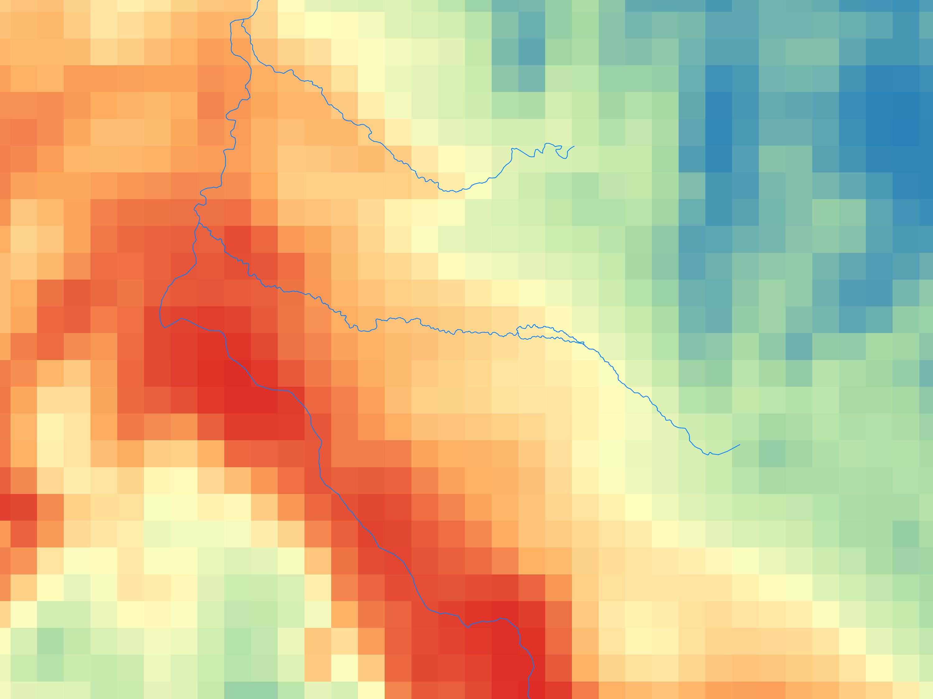
Precipitation
sdf
PRISM
Monthly

Slide 25
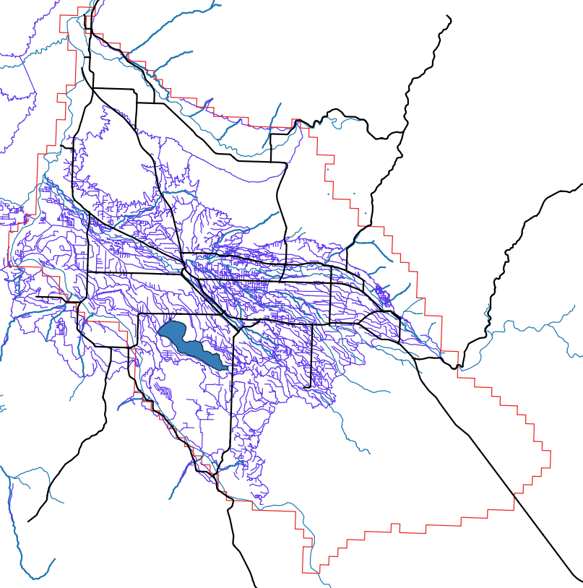
Canal locations
Broad categories
Major, minor, feeder, etc
No properties known other than location
Width, depth, conductance

Slide 26
GW rights
Point of diversion record provides location, type, and right
Used to estimate cells in which estimated pumping occurs

Slide 27
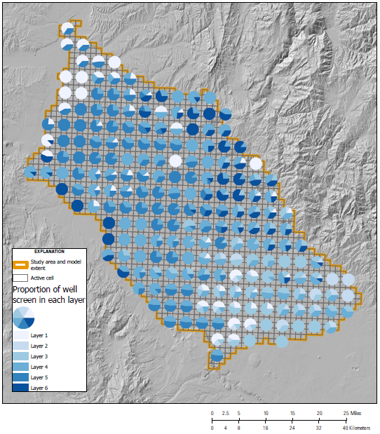
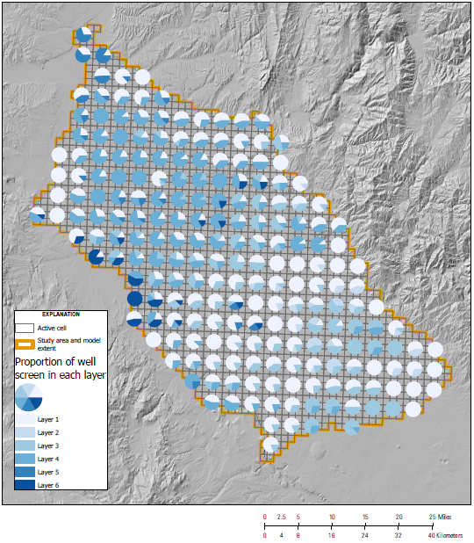
Well construction
Irrigation wells
Domestic wells
Subset of well logs of each type were retrieved
Open intervals were recorded
Synthetic wells were placed, using a weighted average of open length in different layers

Slide 28
Approach
Calculations
Parameters
Demand and supply utility

Slide 29
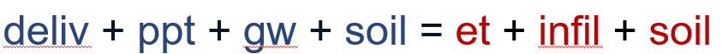
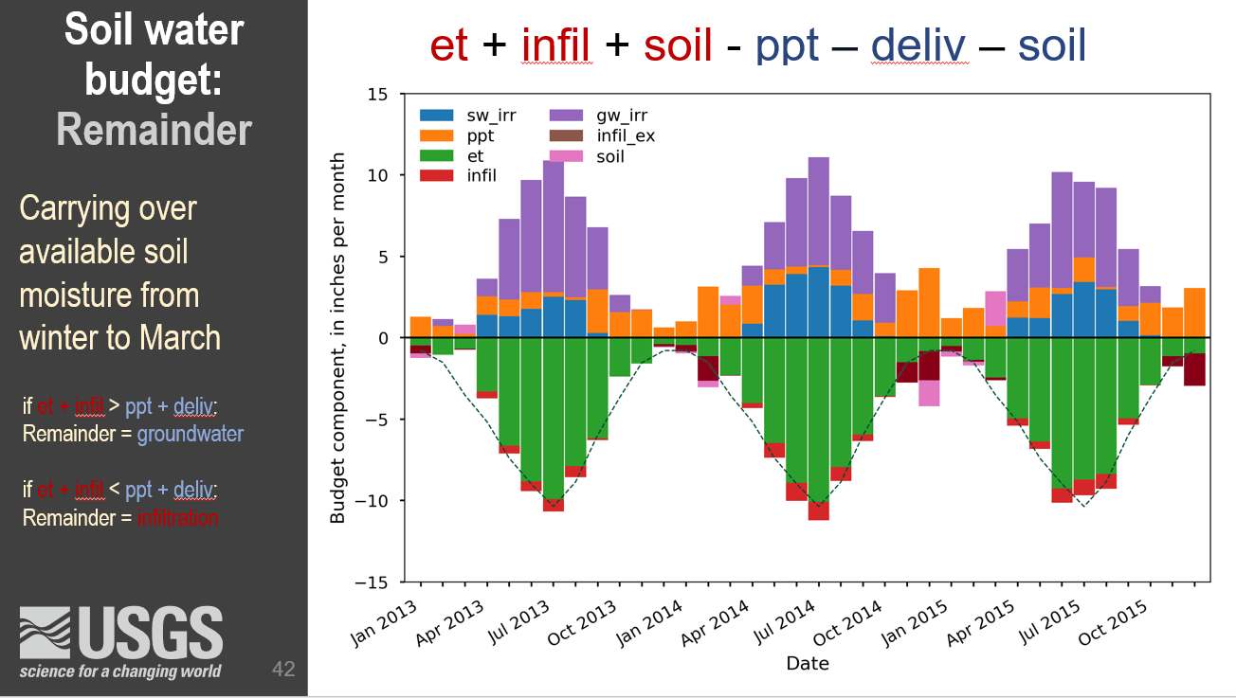
Approach

Slide 30
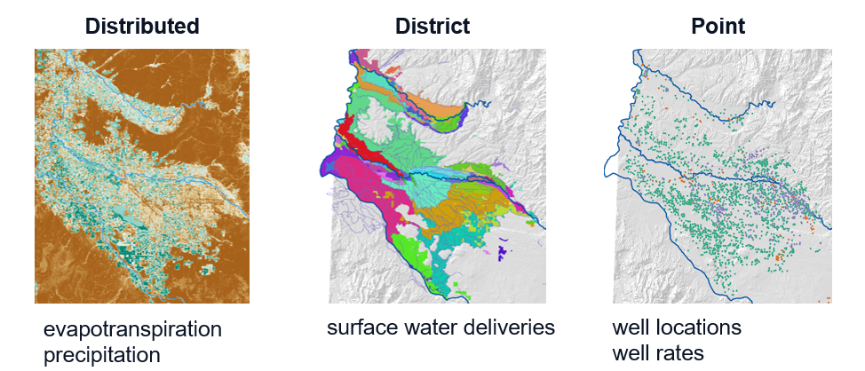
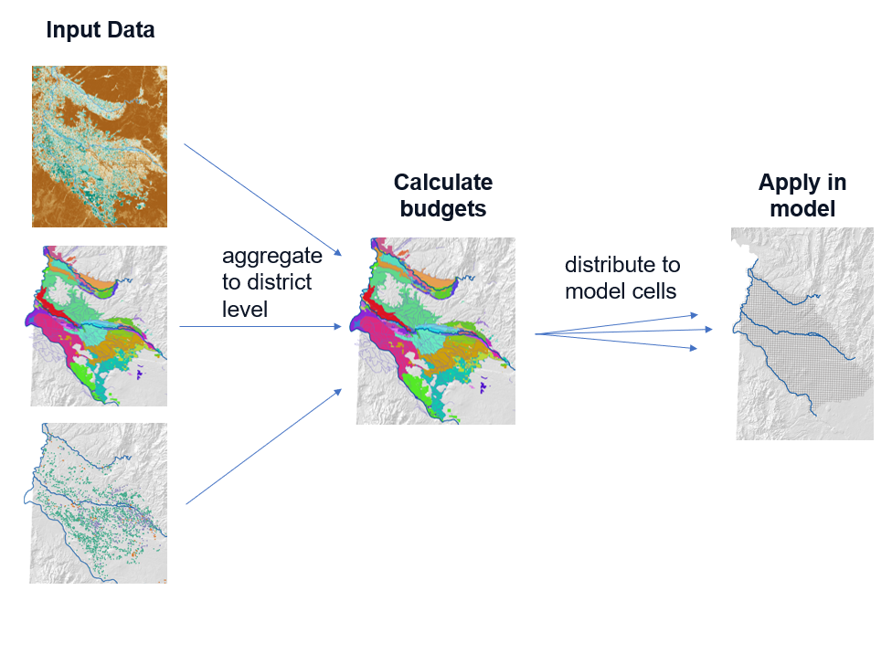
Spatial Scale
Inputs are at multiple scales
Leakage, pumping, irrigation infiltration are calculated at irrigation entity scale
Stresses then distributed to cells
Distribute using finer-scale information
ET
Irrigated lands
Canal location
Well water rights

Slide 31
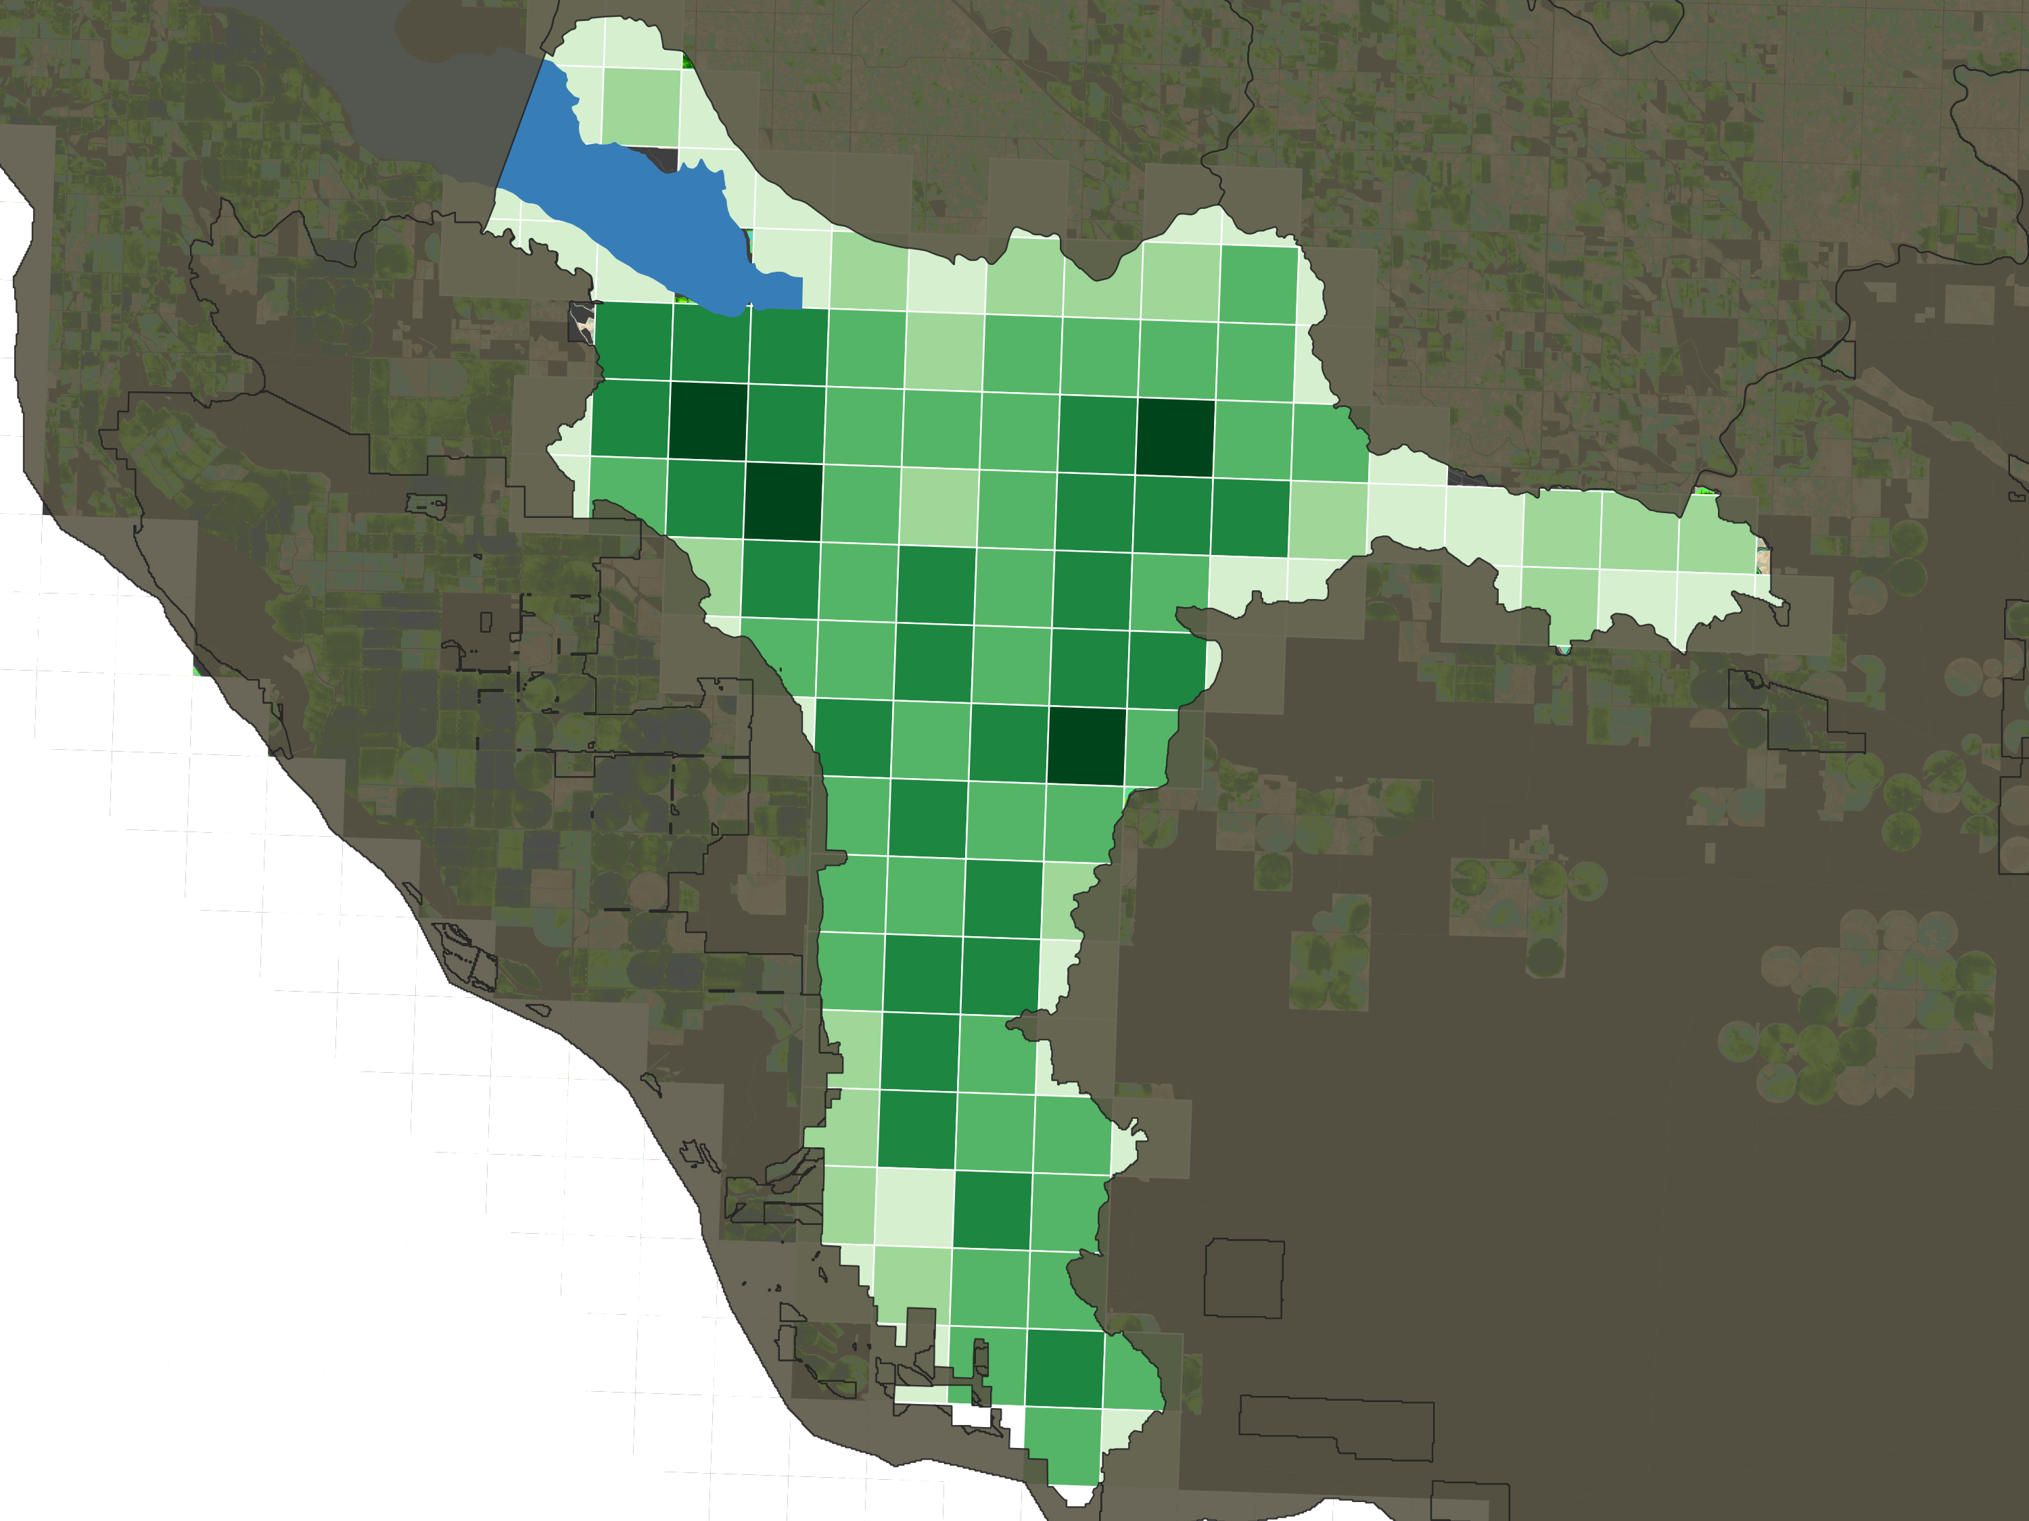
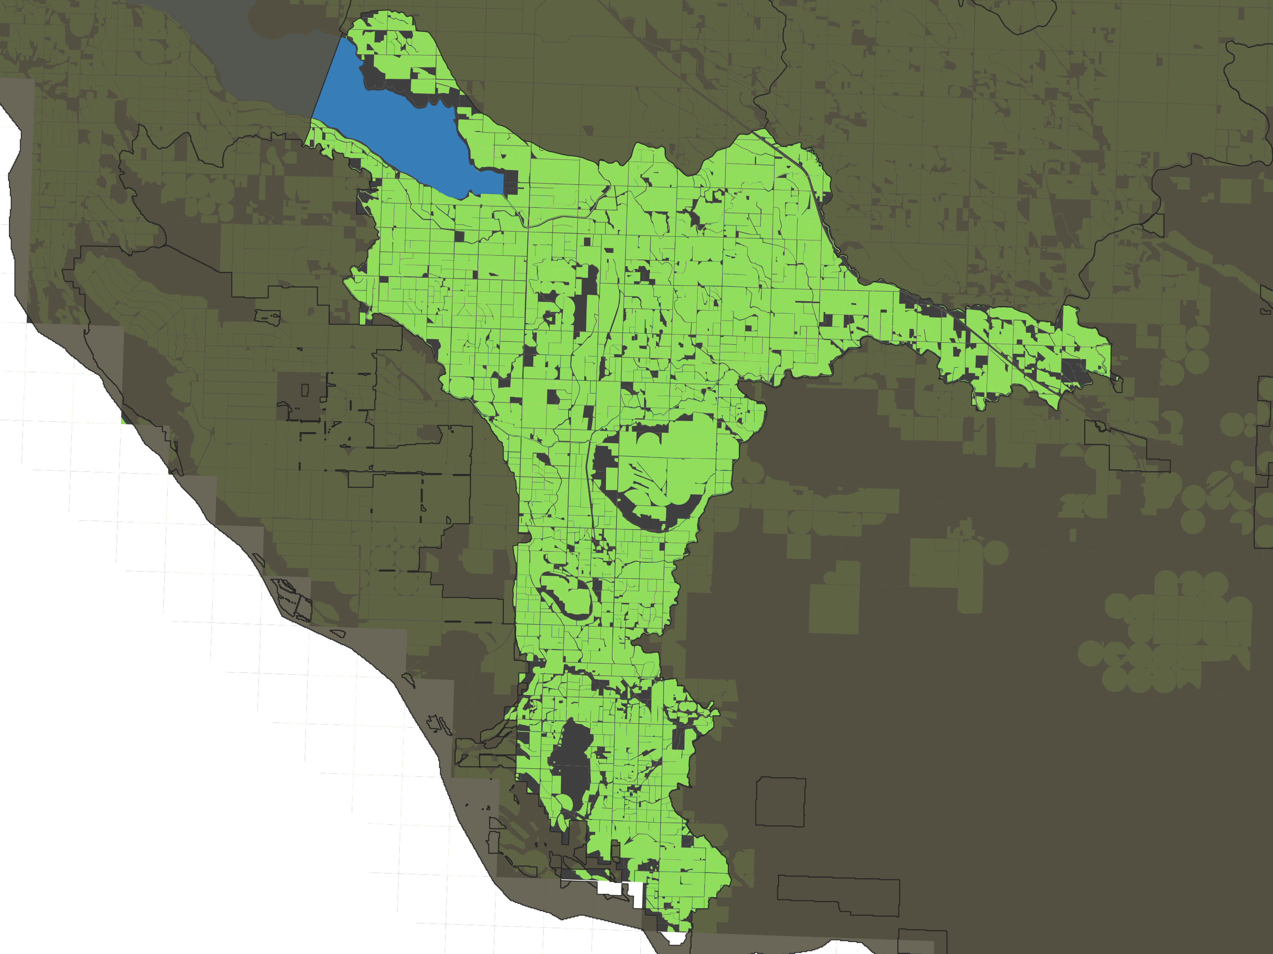
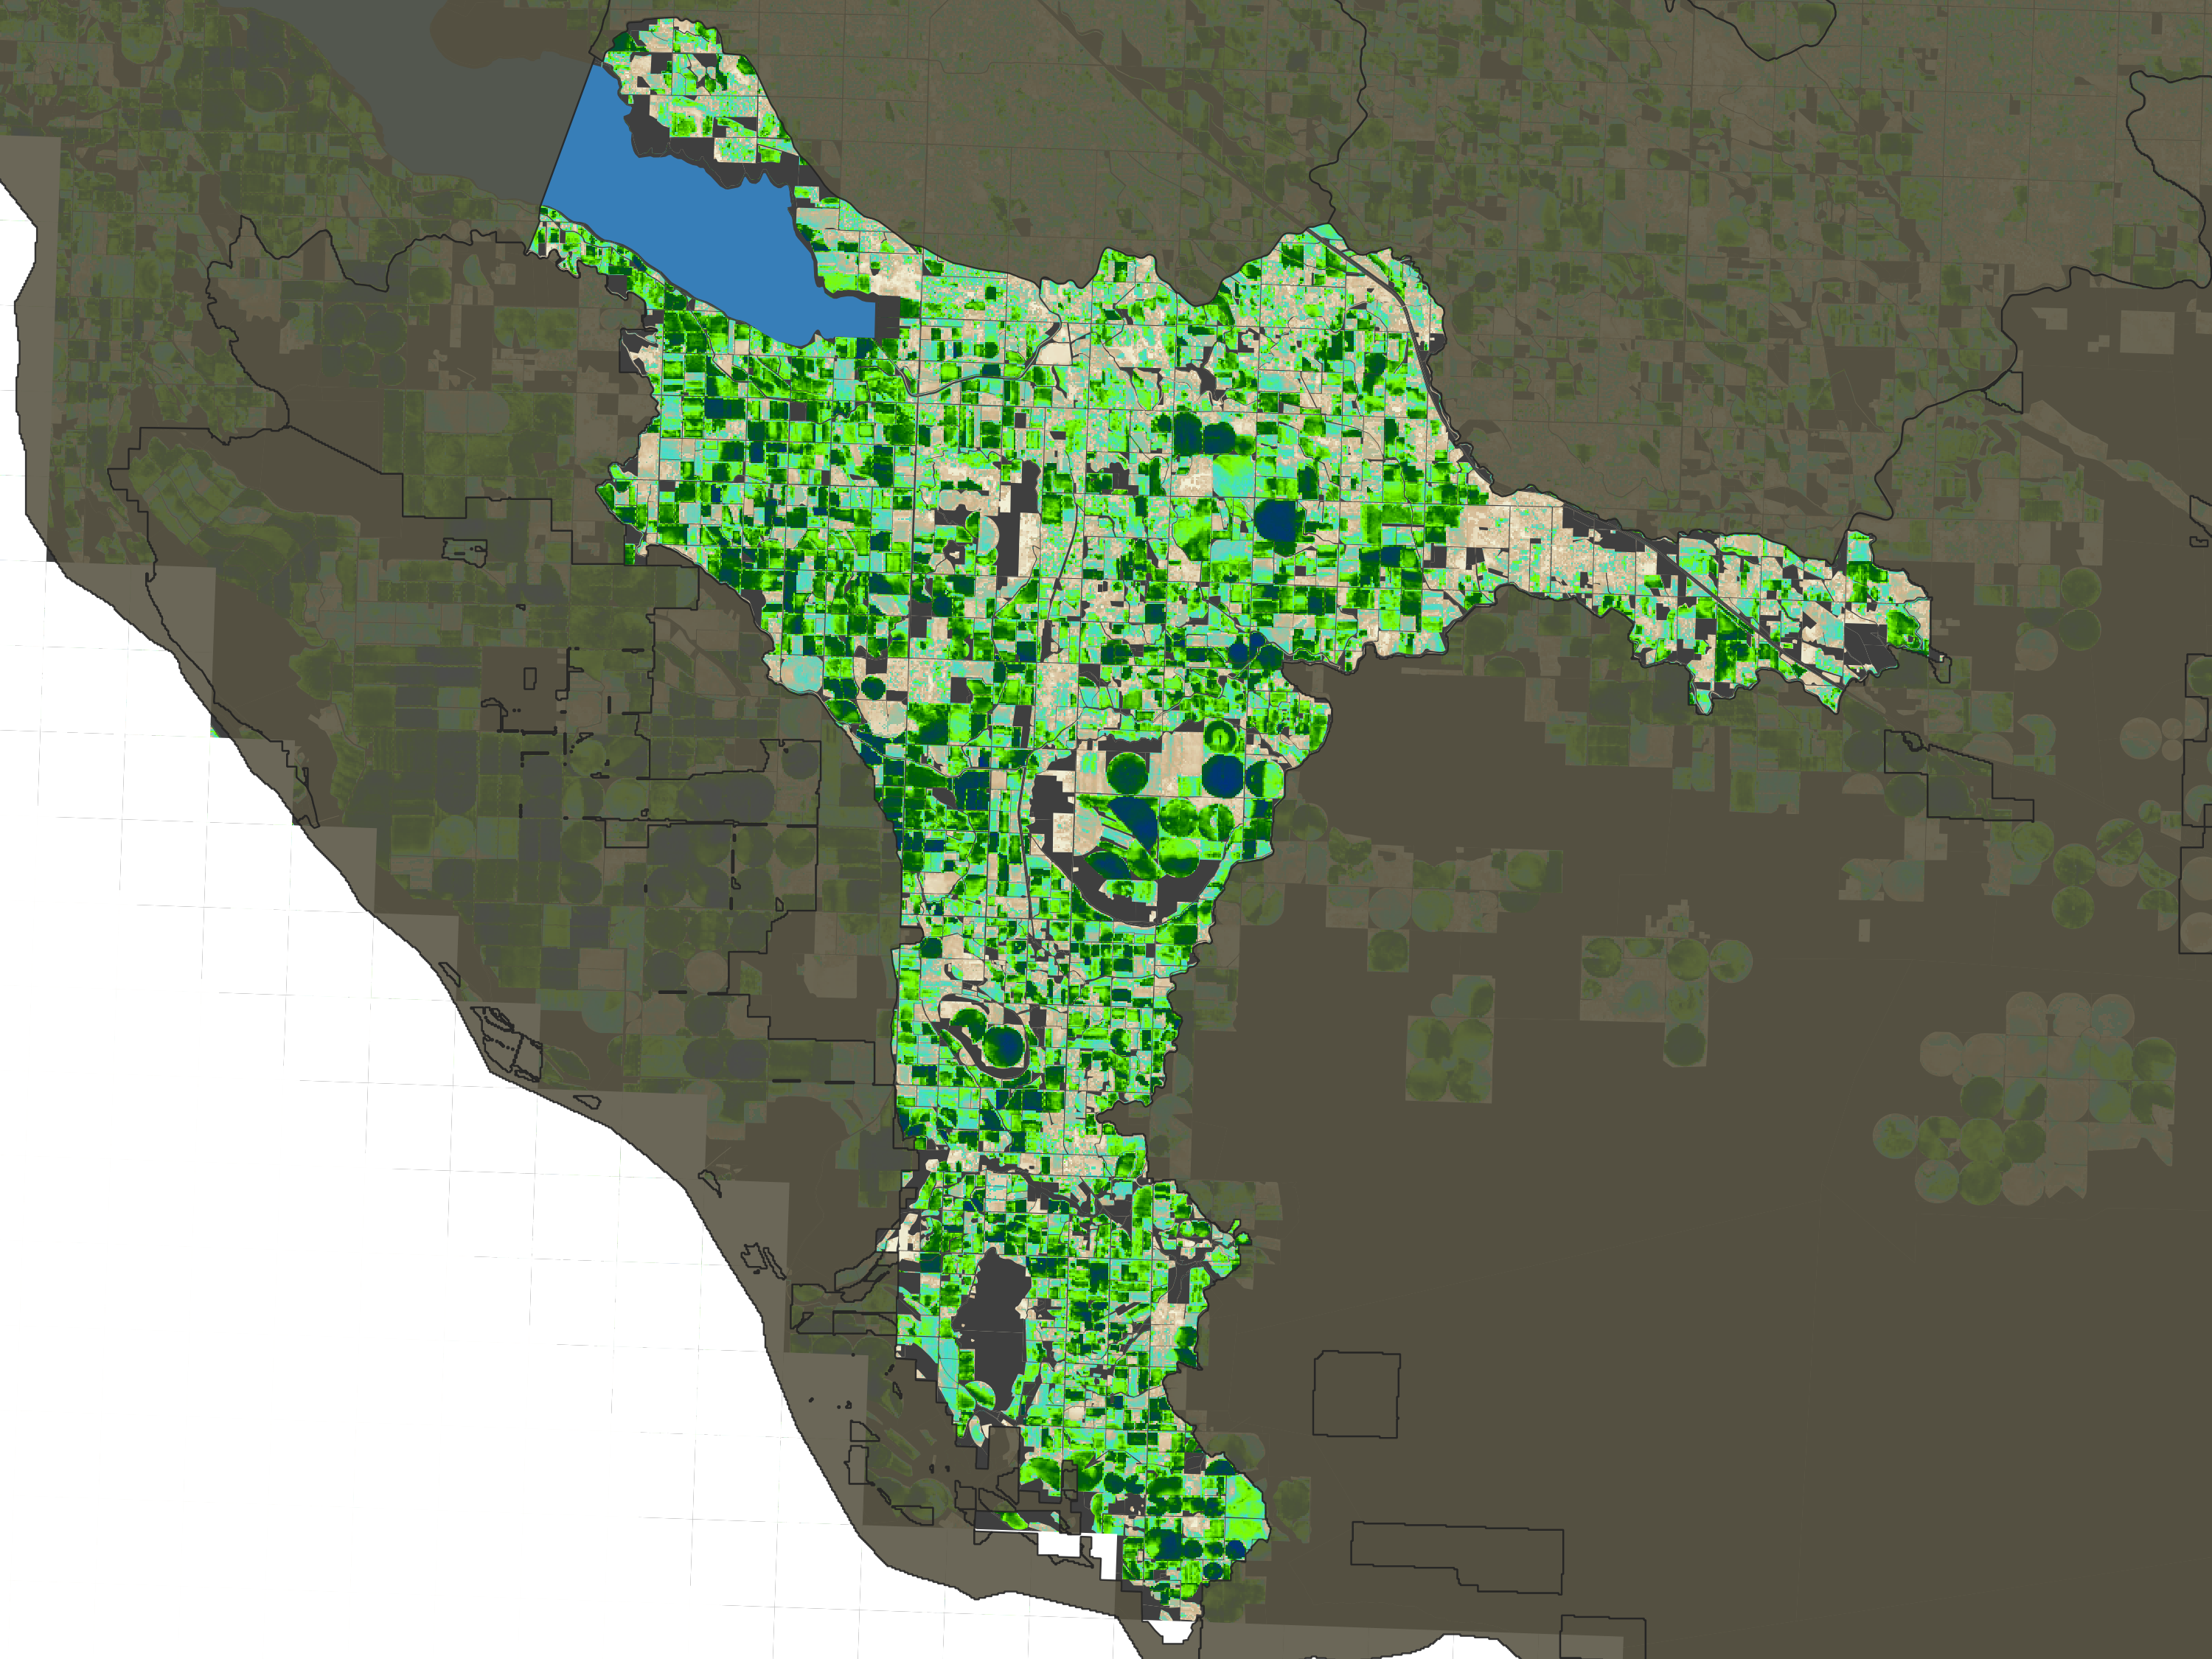
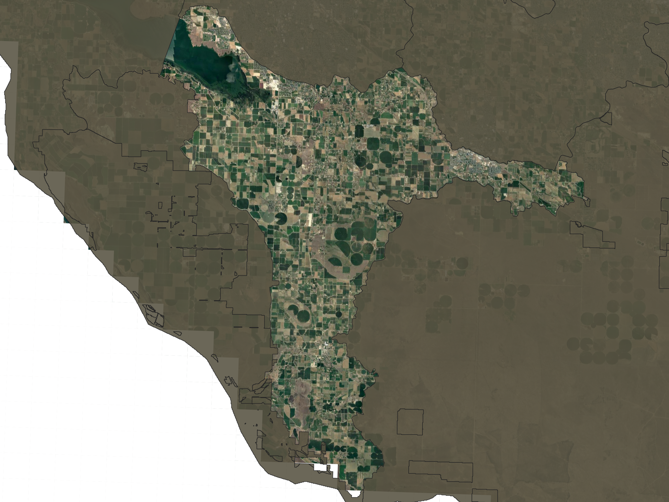

Spatial distribution
Infiltration: ET and irrigation status

Slide 32
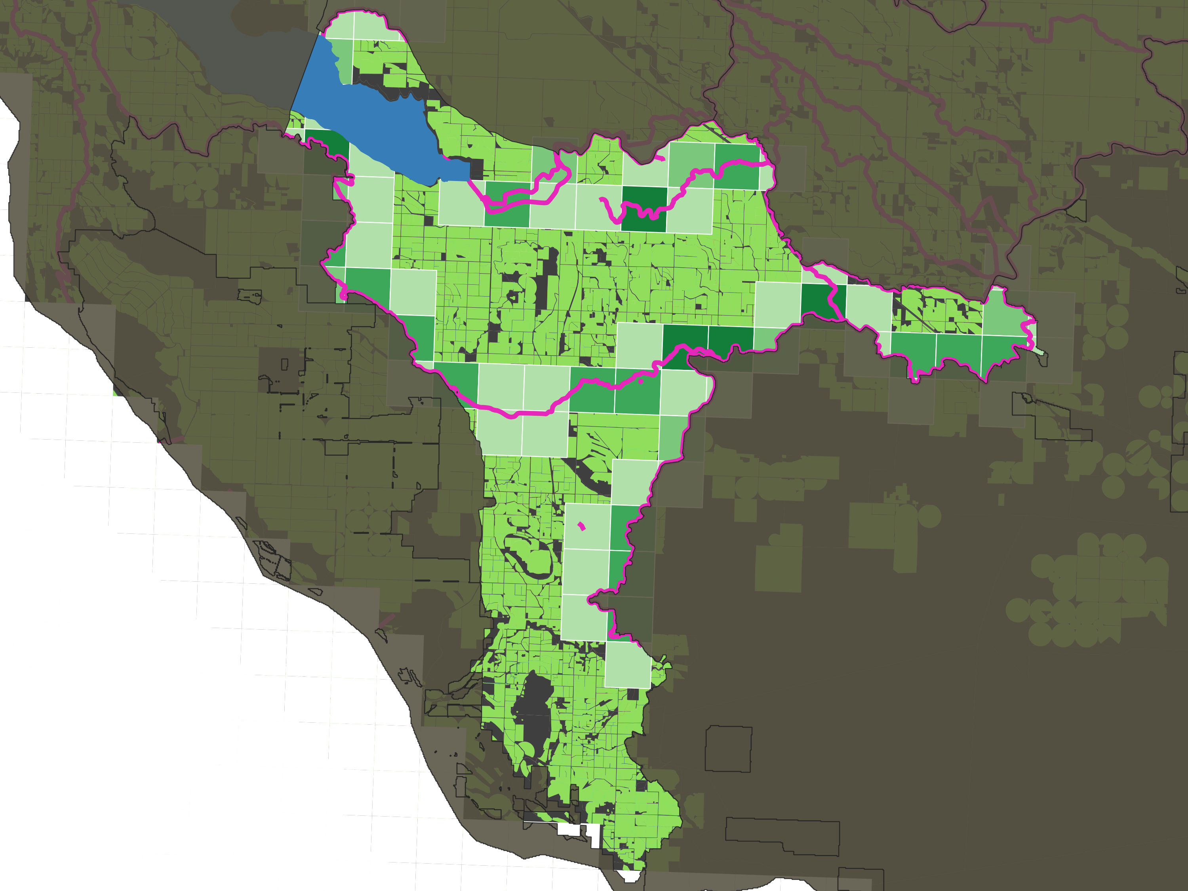
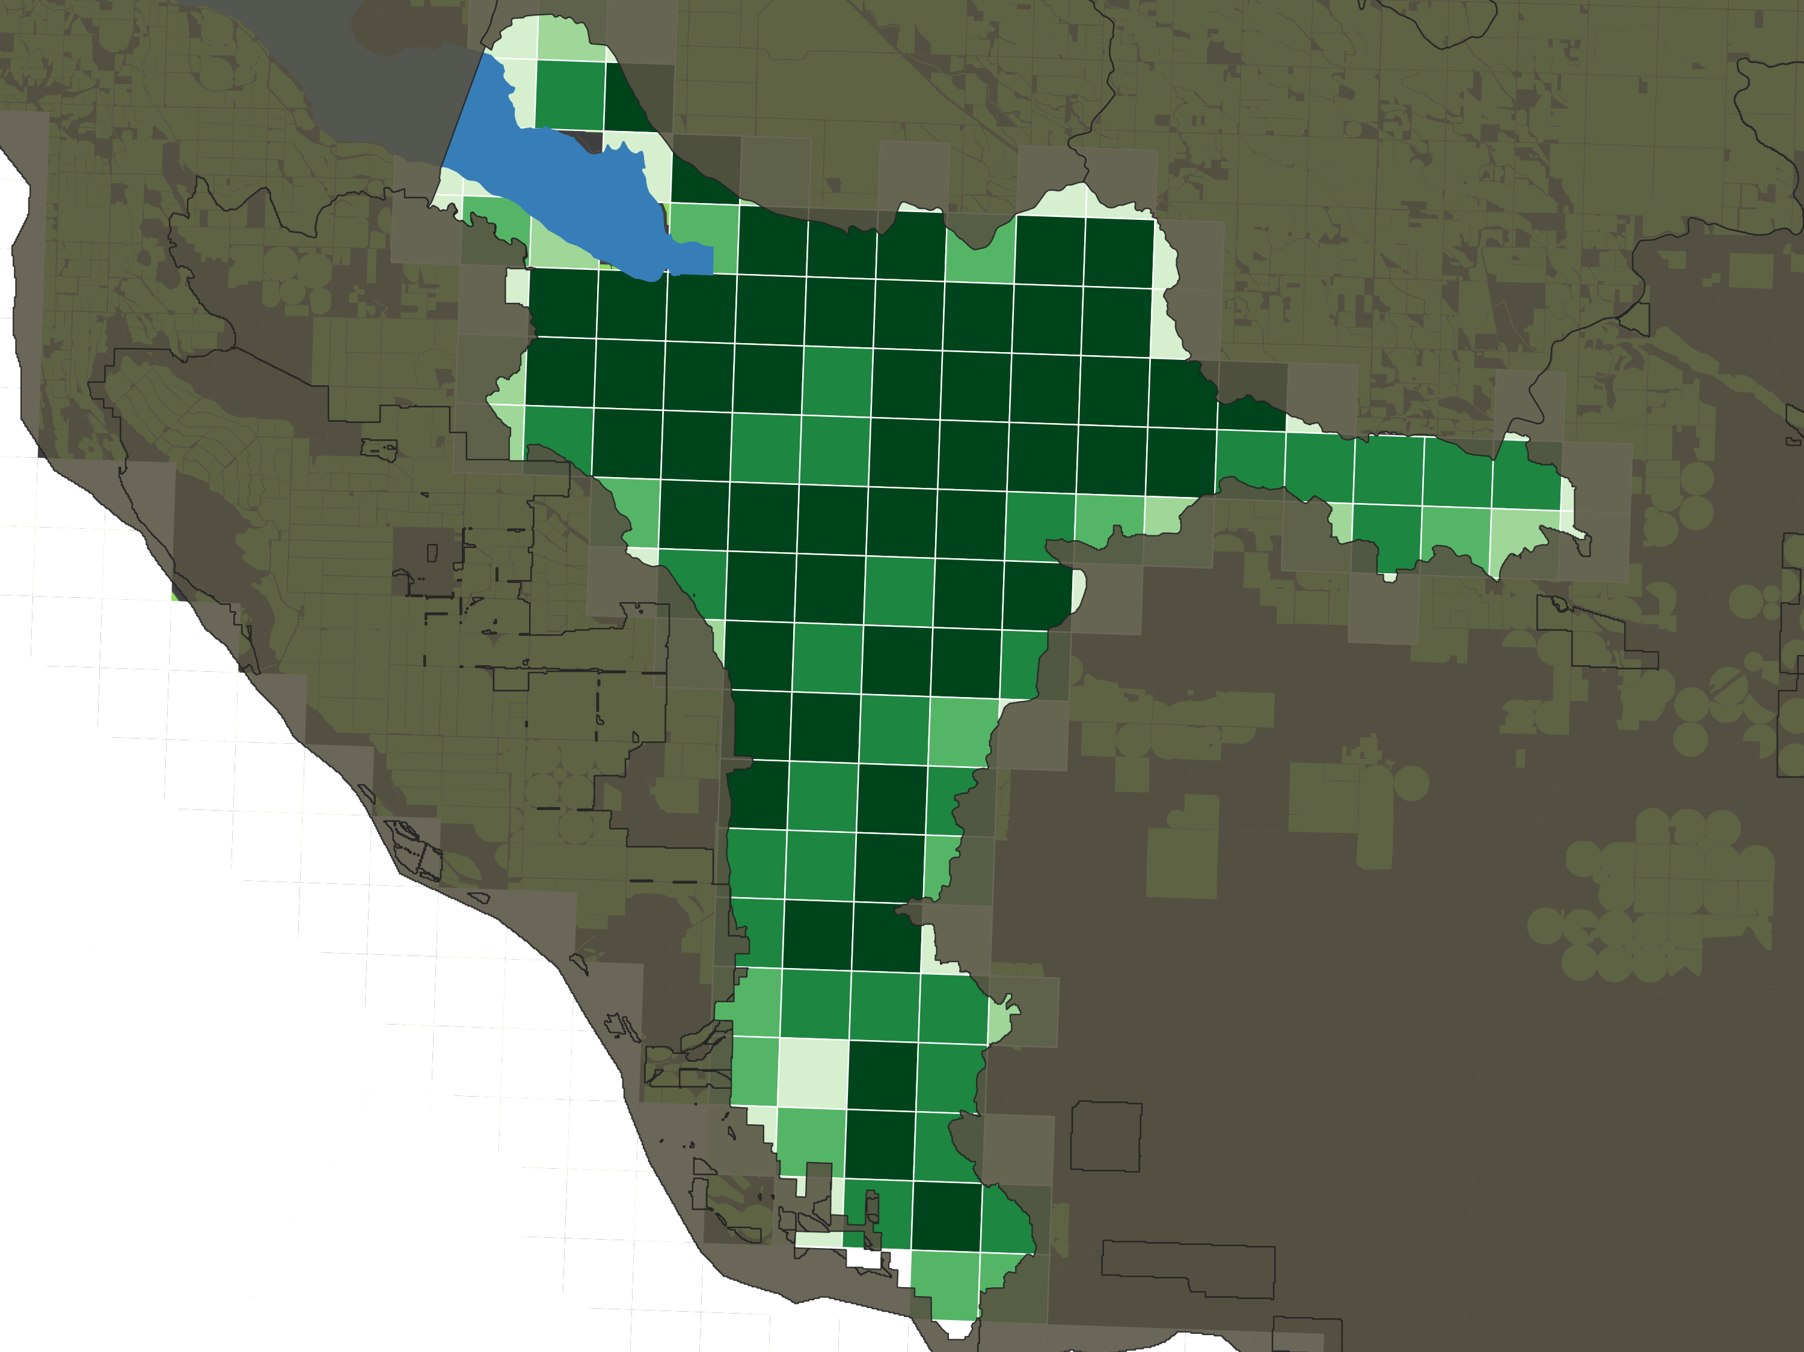
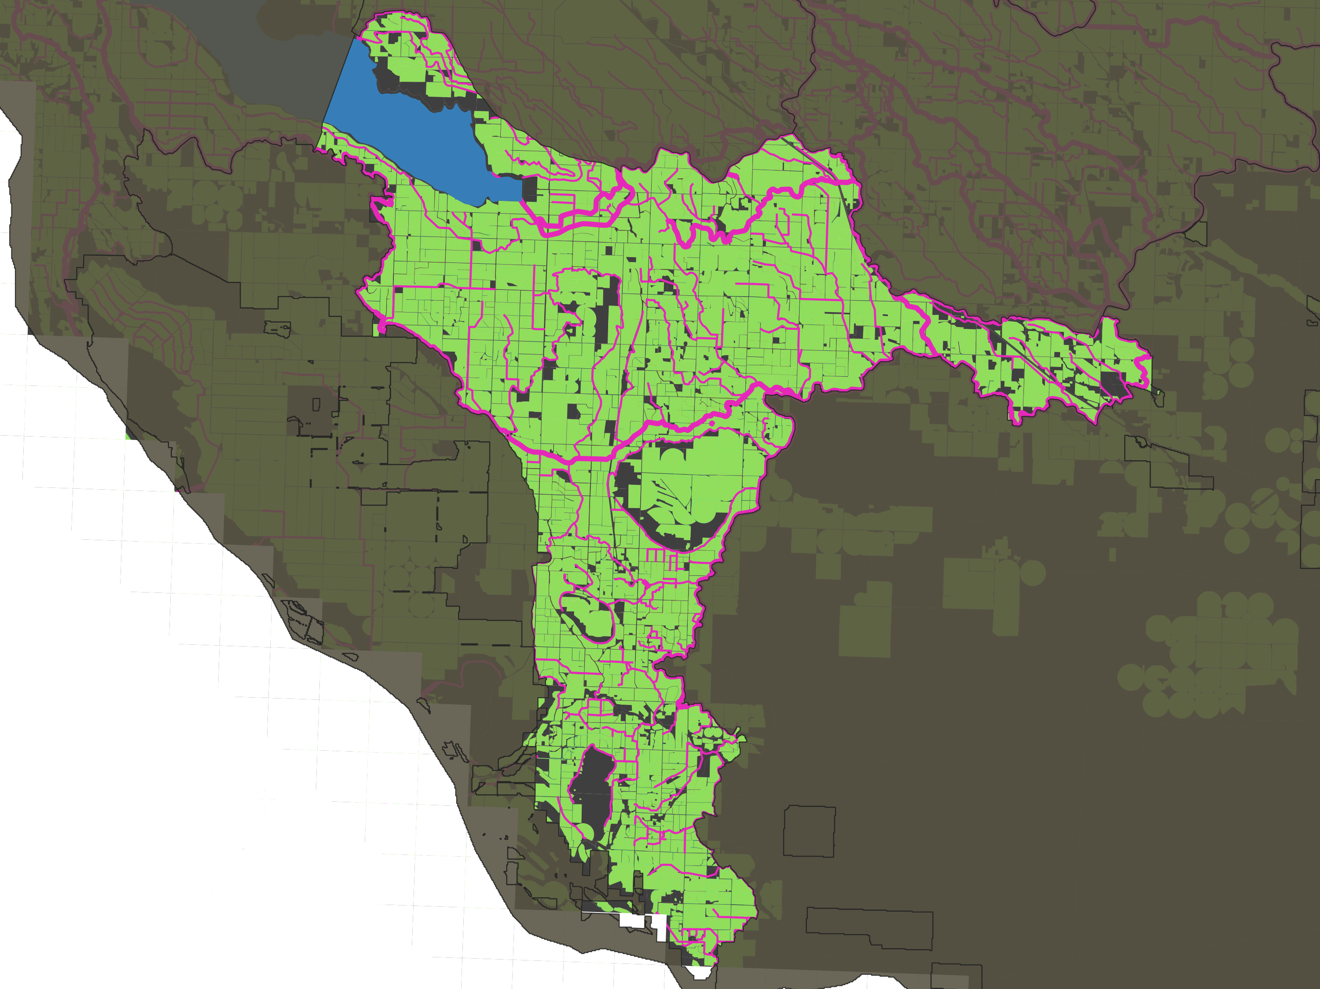
Spatial distribution
Canal leakage
Proportional to irrigated area
AND
Proportional to major canals
Estimated tradeoff

Slide 33
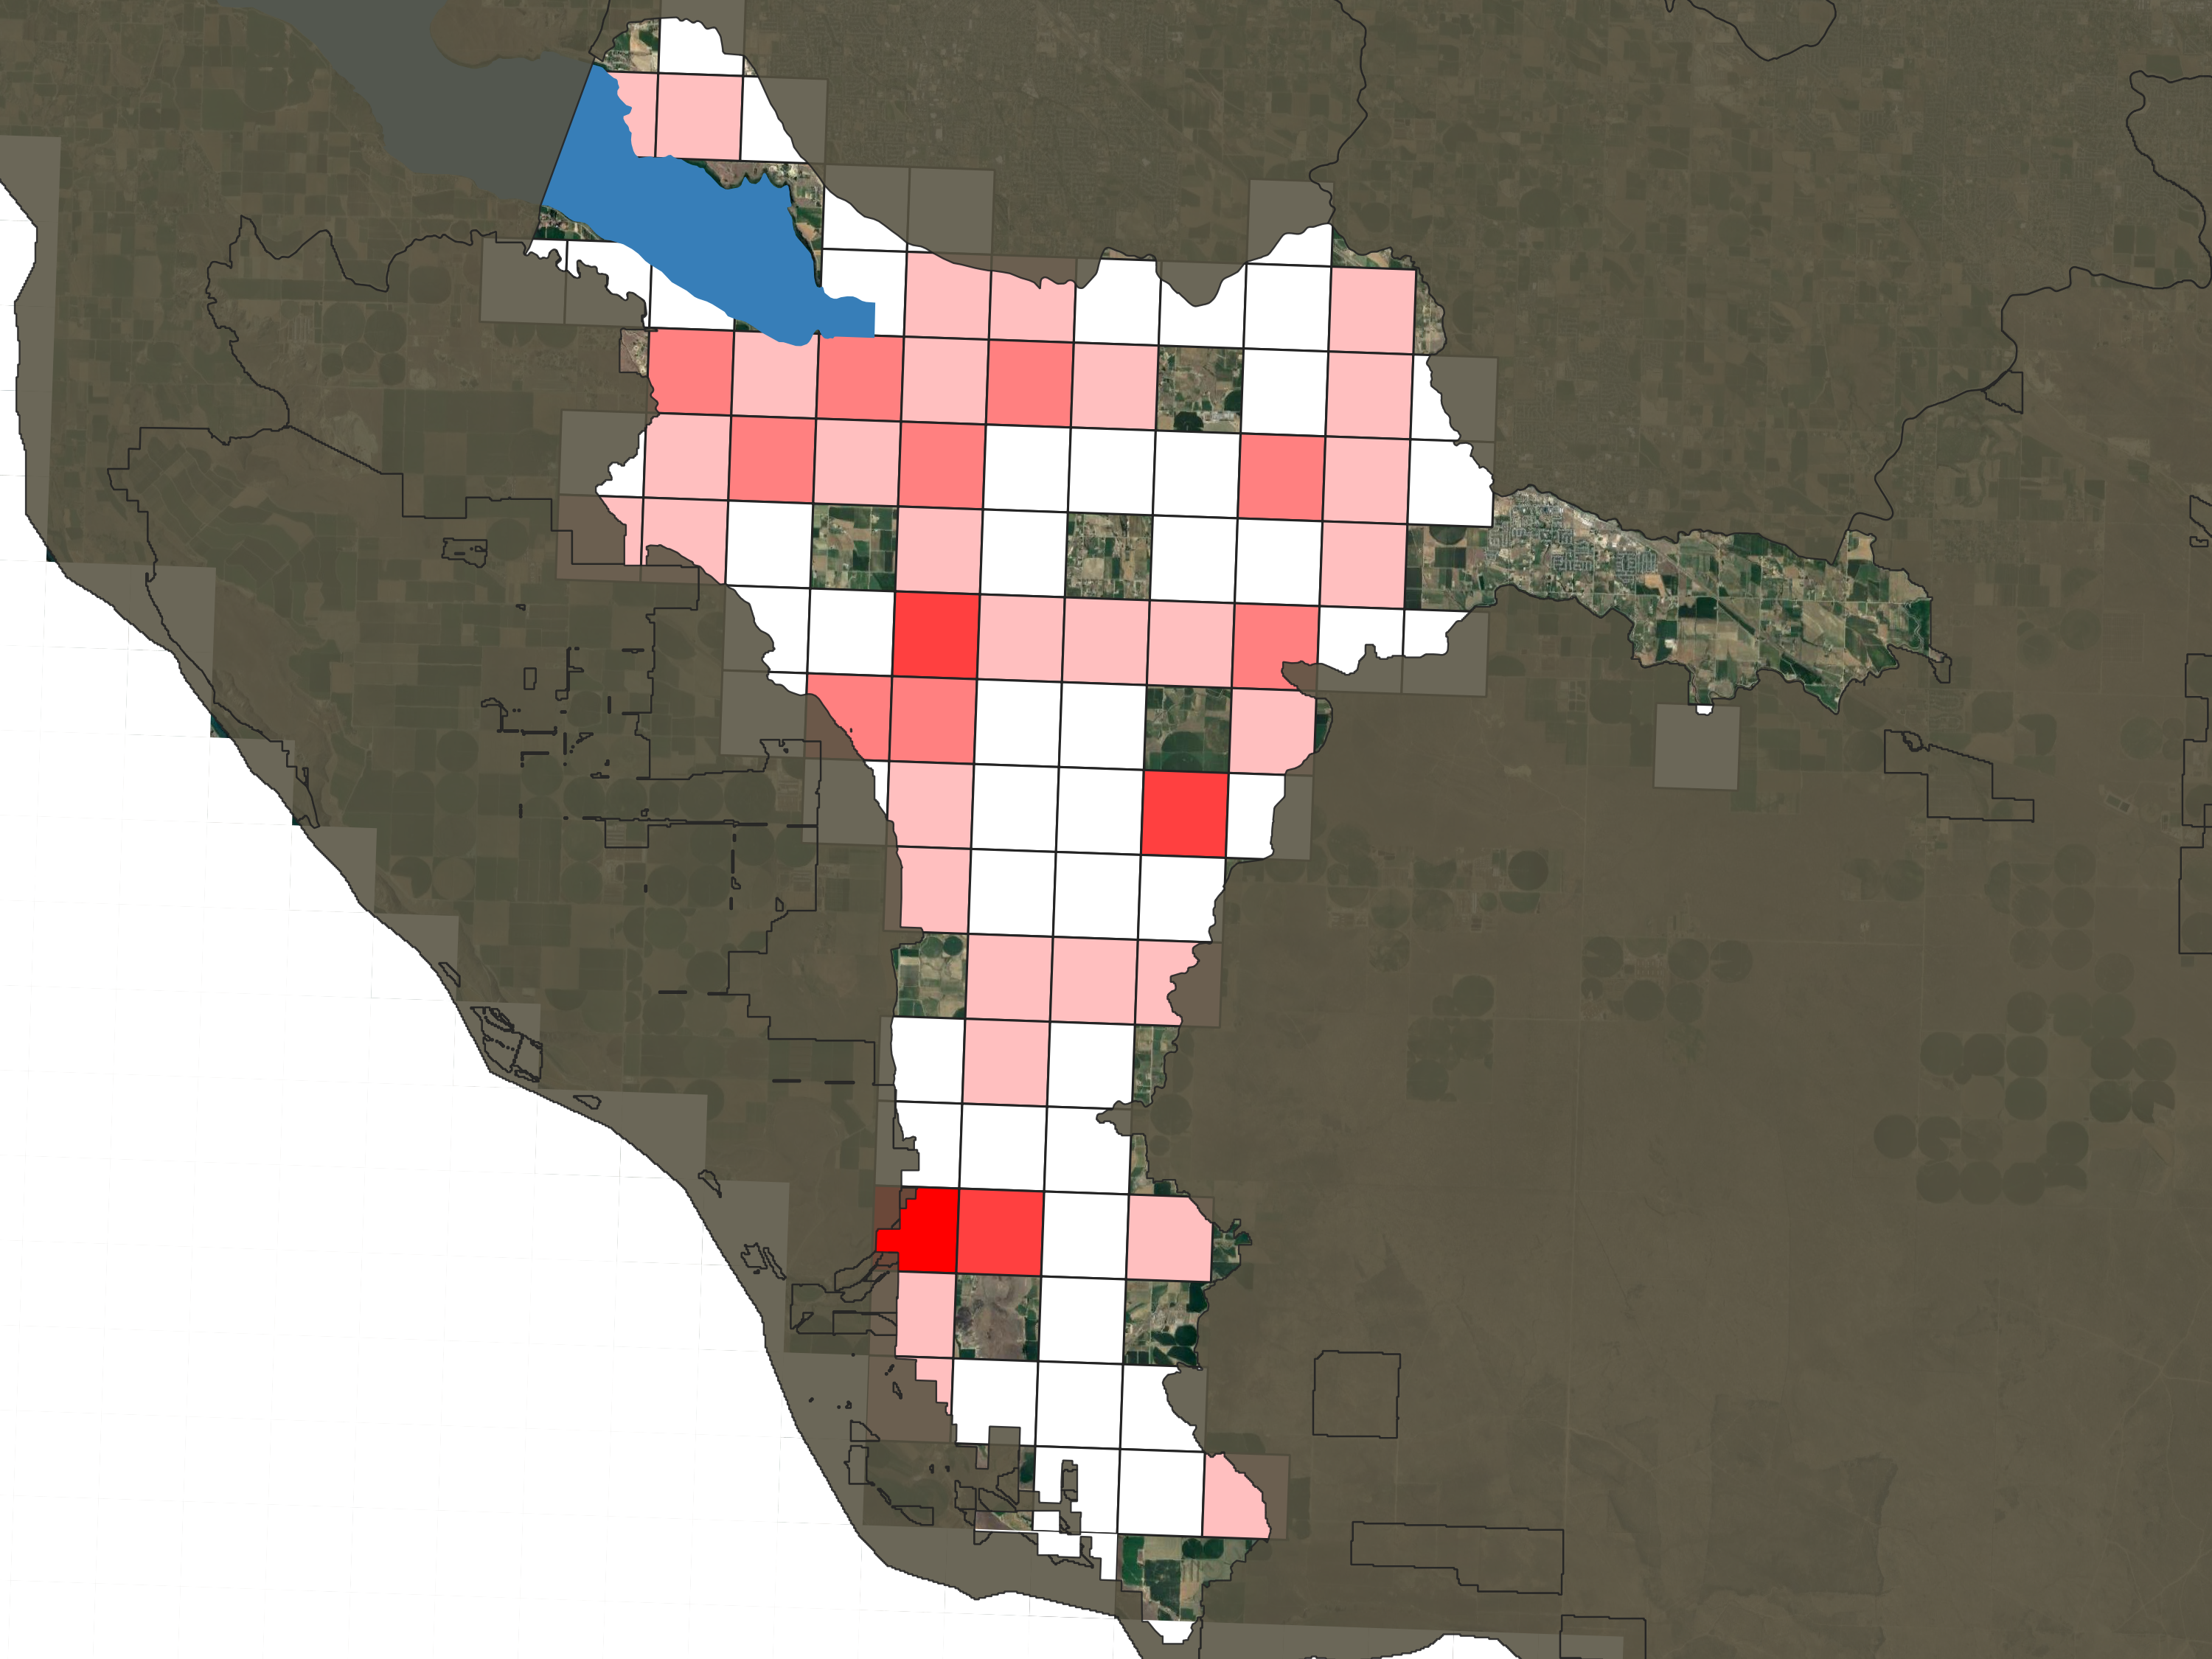
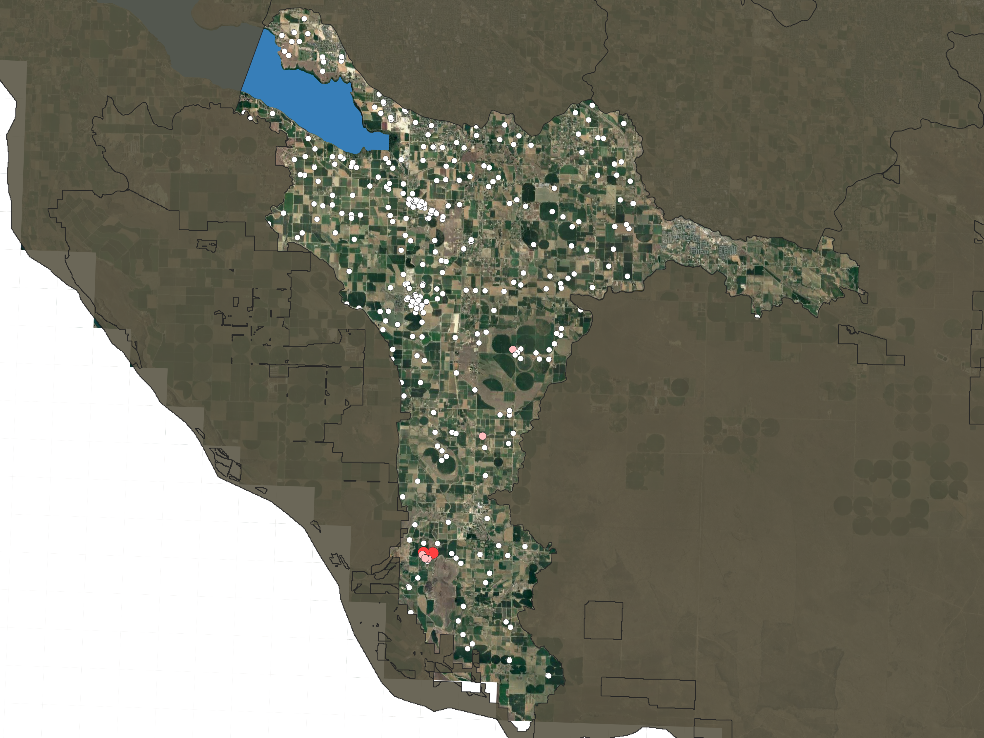
Spatial distribution
Unmeasured pumping
Proportional to GW right

